Slide 1

Example:

Slide 2

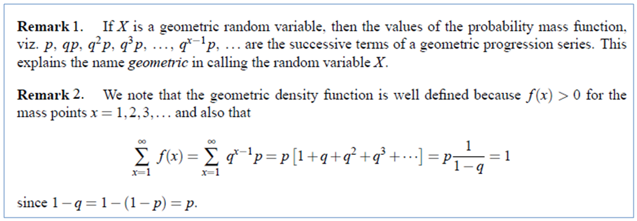

Slide 3
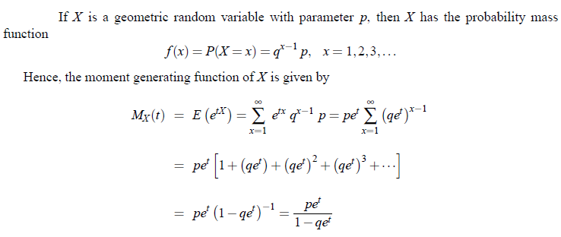
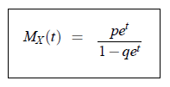
M.G.F, Mean and Variance of Geometric Distribution

Slide 4
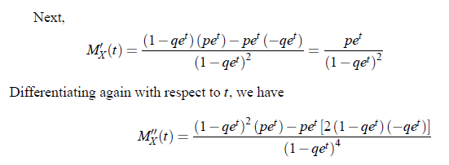
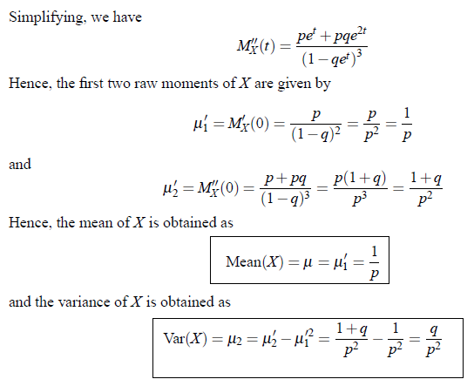

Slide 5



Problem:1

Slide 6



Problem:2

Slide 7
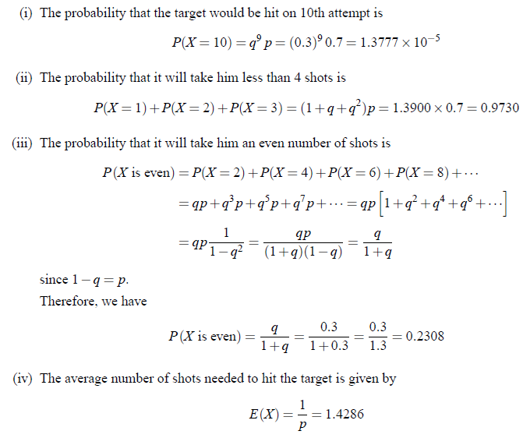

Slide 8

Problems for Practice

